Slide 1

Airframe team n-2 rocket wk4
VIVIAN MWANGI
&
MARK ODHIAMBO

Slide 2
CRADLE FABRICATION
We started on cradle fabrication.
This included marking out of the purchased wood blocks , cutting to required shapes and then filing to obtain a fine surface finish
We assembled the fabricated wood to a stand plate for the purpose of enhancing stability.
See illustration on the pictorial slide

Slide 3
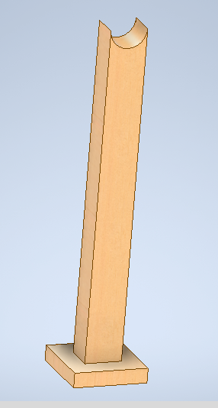
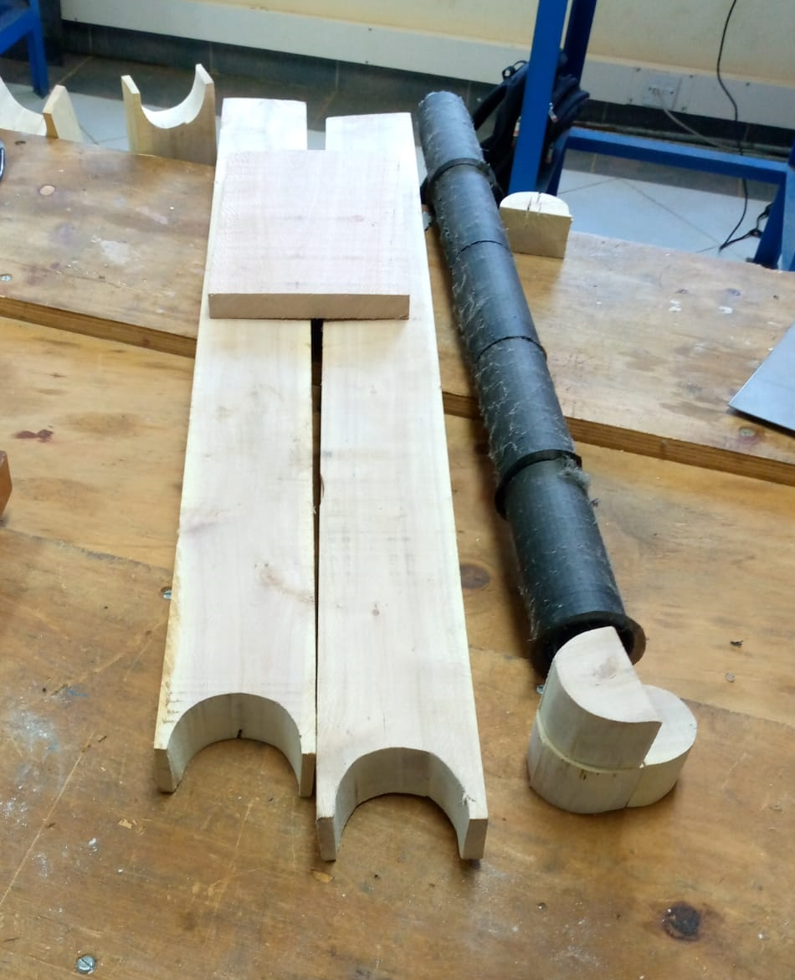
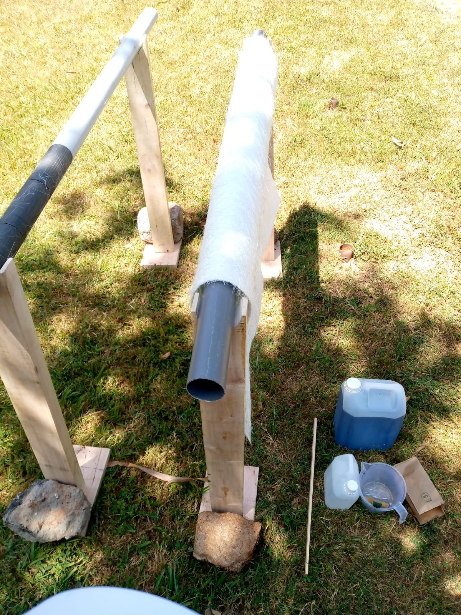
Cad design / Pictorial for cradle

Slide 4
Body-tube fabrication
We managed to make two prototypes for the body-tube.
Method used:
We set out our workstation in an open area
We analyzed and read the chemical safety guidelines
We wrapped nylon paper on our body tube mold and stuck it with tape
We mixed resin and catalyst in directed proportions and stirred
Using a brush we applied the resin to the fiberglass until we obtained desired thickness
We left the fiber glass body tube to dry
We disassembled the nylon from the body tube

Slide 5
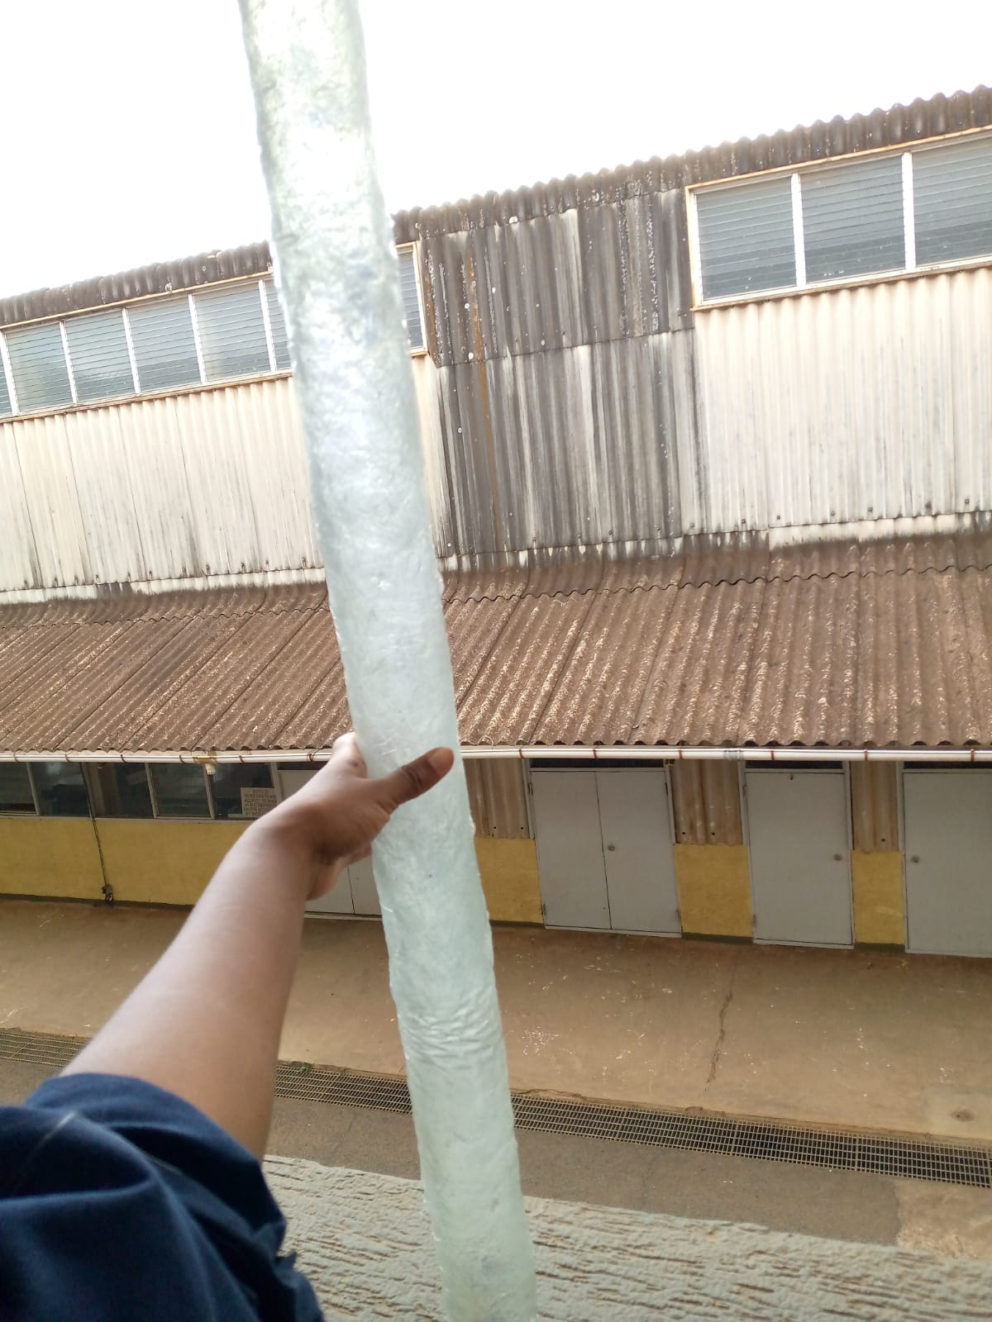
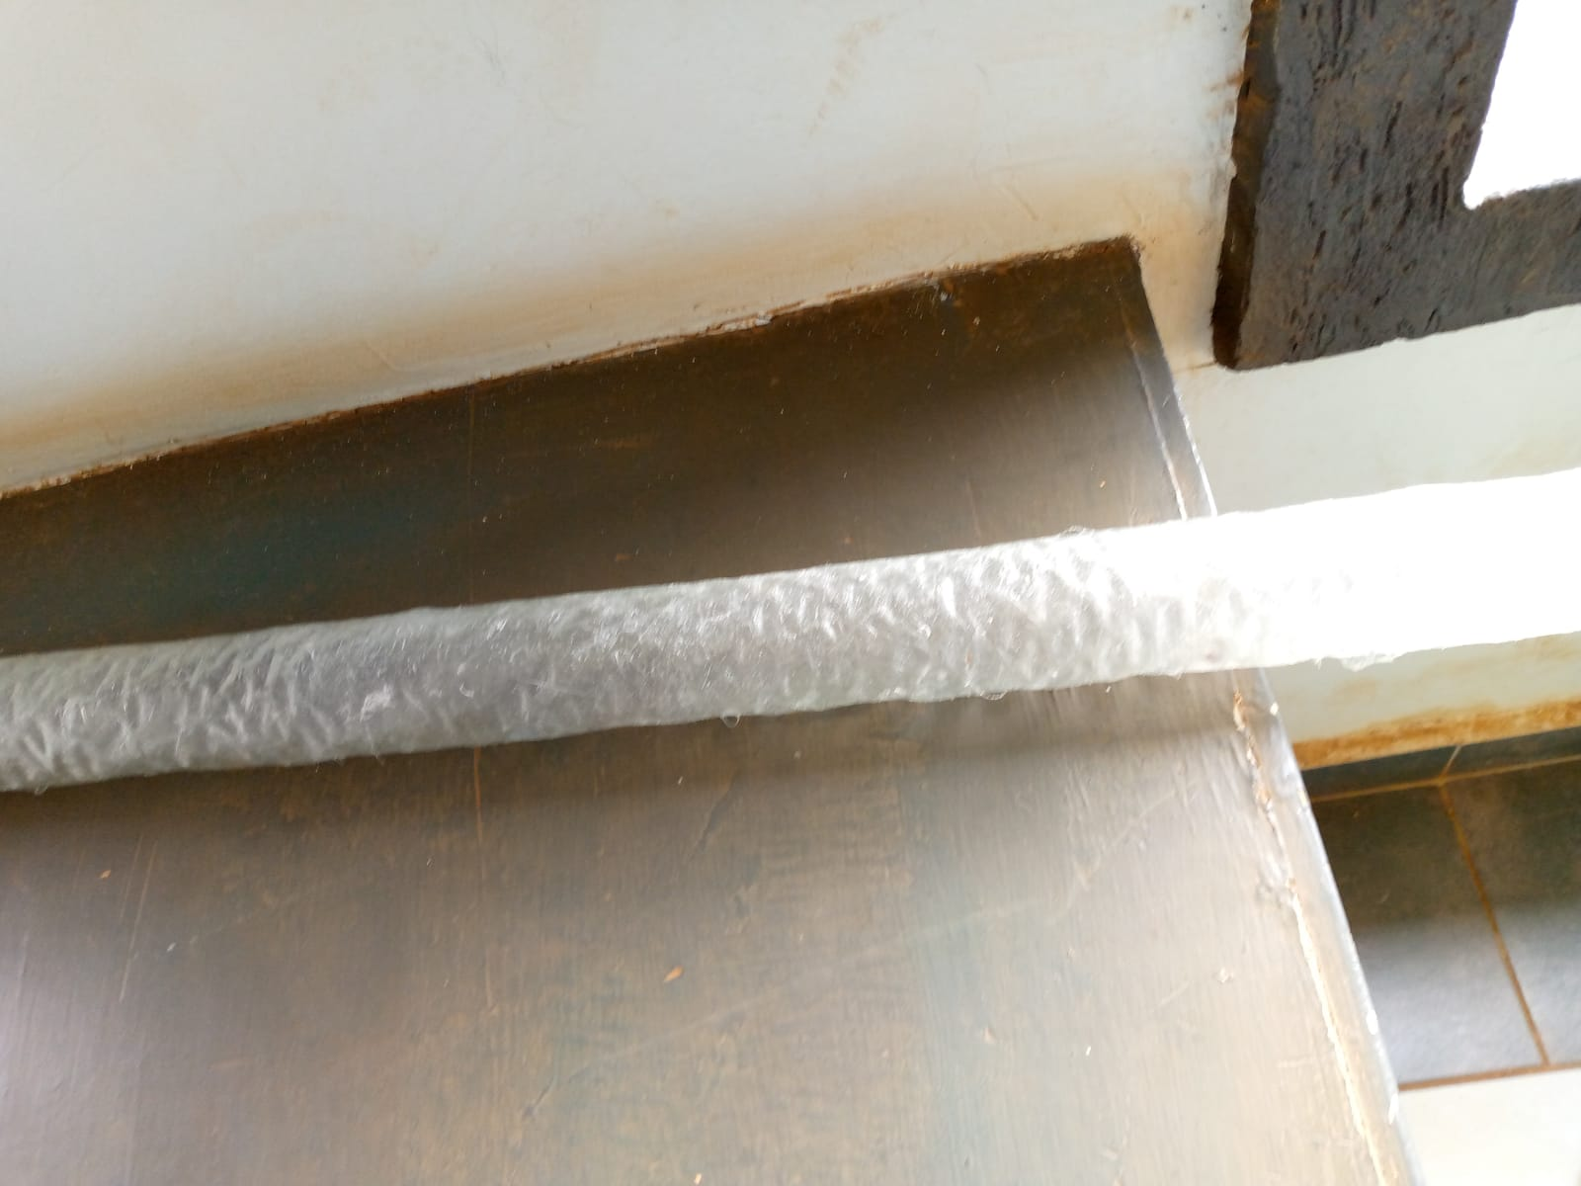
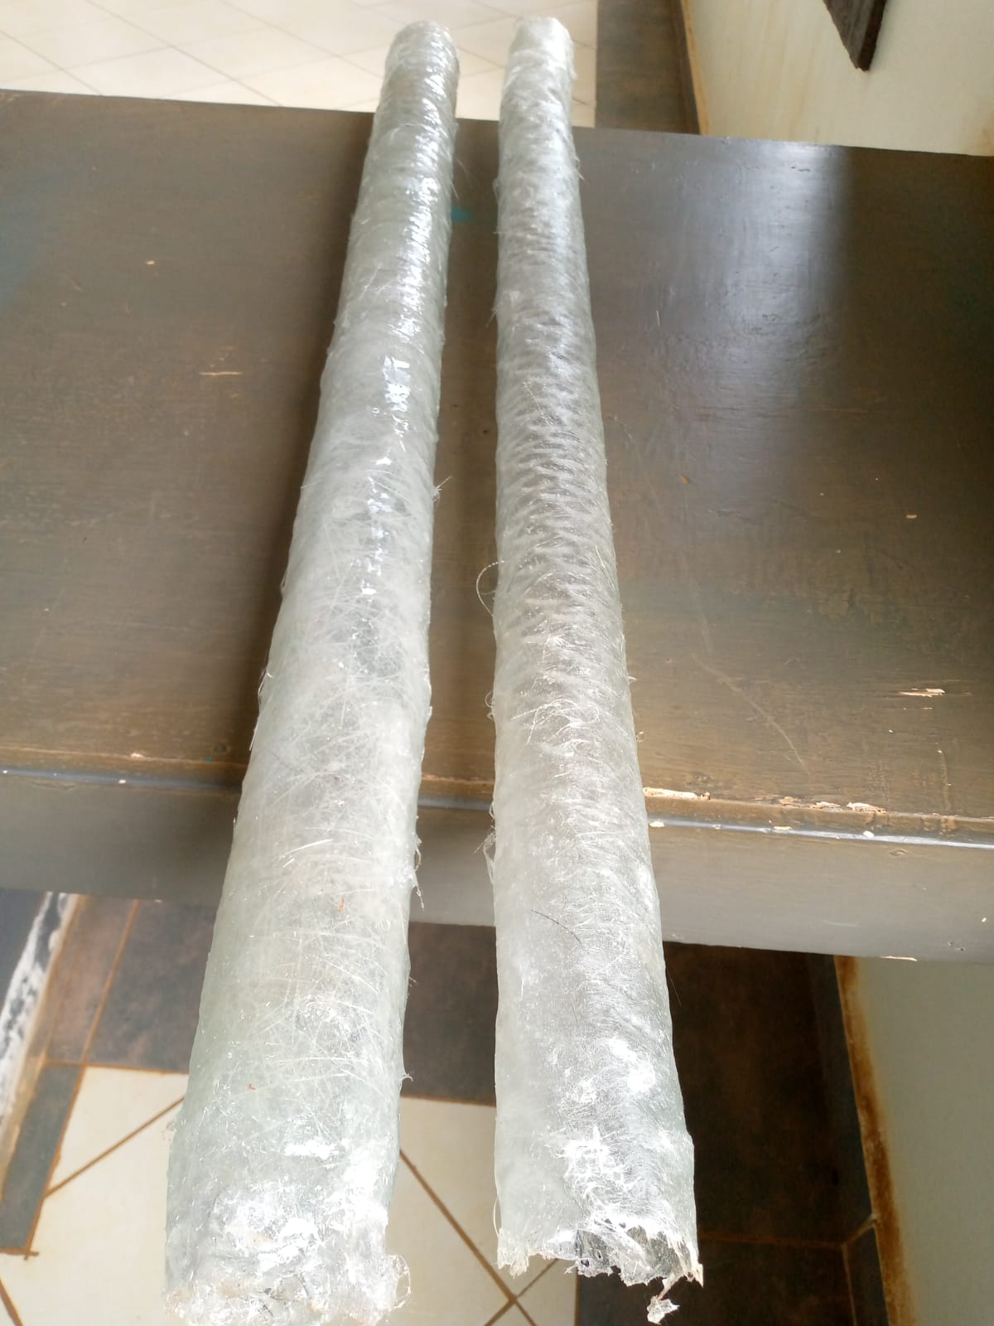
Pictorial of fabricated body-tubes

Slide 6
Analysis of the fabrication process
From our first prototype, it was discovered that several air bubbles were formed after the body-tube dried.
It was also discovered that the thickness of the body tube was very large and it was necessary to reduce the weight
From our second prototype, we tried to eliminate the air bubbles and at the same time reduce the thickness of the tube
The air bubbles were observed to have reduced significantly
The thickness of the tube was smaller than anticipated
The nylon laid at the beginning made the interior of the tube have wrinkles

Slide 7
Defects present analysis
Formation of air bubbles
HOW TO REDUCE:
MAKE THE ANGLE OF APPLICATION/SPREADER AS LOW AS POSSIBLE TO AVOID SCRAPPING OFF FRESH RESIN
FIRMLY DRAG THE SPREADER USING LONG AND OVERLAPPING STROKES
CONSIDER USING A ROLLER FOR APPLICATION INSTEAD OF BRUSH
2. Formation of wrinkles on the interior
HOW TO REDUCE:
MAKE SURE THERES A TIGHT FIT BETWEEN THE BODYTUBE MOLD AND THE BASE NYLON PAPER USED TO AVOID WRINKLES FORMATION

Slide 8
Tasks done this week
BODY RIG DESIGN {GitHub issue # 79}
BODY TUBE FABRICATION {GitHub issue # 82}
ANALYSIS OF FABRICATION {GitHub issue # 89}
SECOND FABRICATION OF BODY TUBE {GitHub issue # 79}
ANALYSIS OF SECOND FABRICATION OF BODY TUBE {GitHub issue # 79}

Slide 9
Tasks in this week
Computational simulation of the rocket [Github issue#93]
Tee slot design [Github issue#80]
Engine block design[Github issue#78]
Camera mount design[Github issue#80]

Slide 10
timeline
WEEK 1-material SELECTION, ANALYSIS AND COST
WEEK 2-DESIGN AND SIMULATION.
WEEK 3-SIMULATION CORRECTIONS.
WEEK 4-ASSEMBLY AND FABRICATION.
WEEK 5-ASSEMBLY AND FABRICATION.
WEEK 6- RECOVERY SYSTEM
WEEK 7-FINALISATION.
WEEK 8-TAKE OFF.
PRONE TO CHANGE AS PER THE SITUATION.

Slide 11
THE END
THANK YOU!

